Slide 1
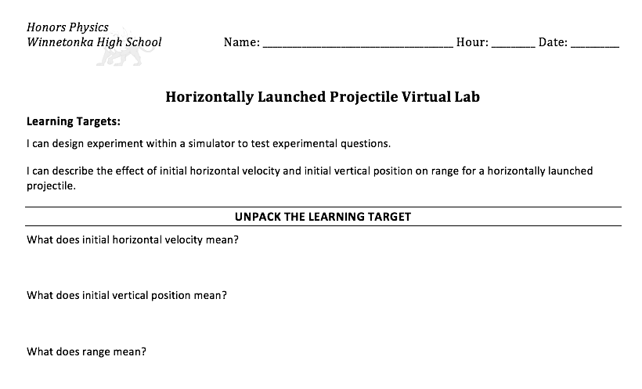
Welcome!!
Pick up a copy of this handout from the counter by the door.

Slide 2
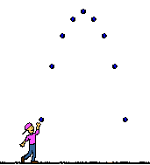
Projectile trajectories
Straight out or
Horizontally launched
Launched at an angle.
Dropped
Straight up

Slide 3
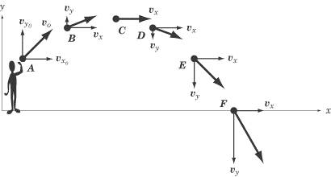
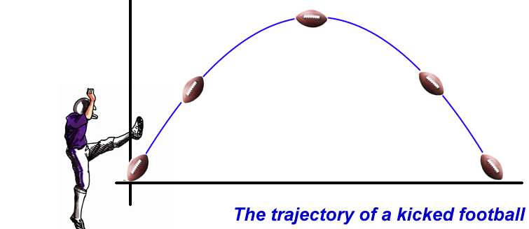
Projectiles
Definition:
A projectile is an object moving through the air and the only force acting on it is the force due to gravity.
Force Diagram for a Projectile:
F_{g}
The graphic above shows the VELOCITY VECTOR components at various places along the projectile’s trajectory.
An object in free fall is a projectile.
The horizontal and vertical components of a projectile’s motion are independent of one another.
The acceleration of gravity causes the projectile to speed up, slow down or change directions vertically.
A projectile’s path is called its trajectory. The shape of the trajectory is parabolic.
Landing
KEY CONCEPT: The acceleration of gravity does not affect the horizontal motion at all! Therefore, the horizontal motion of a projectile is at constant velocity.
Range
Peak
Height
Special case about the range:
When a projectile is launched at 45º,
it reaches the maximum range.
51
Launch

Slide 4
Go to the
district webpage:
Choose Student Links:
Select Canvas:
Log in with your lunch number and password.

Slide 5
When you choose Honors Physics,
this should appear on the Home page:
Password:

Slide 6
Projectiles
Force Diagram:
Examples:
Non-Examples:
Birds
Planes
Gliders
Rocks
Baseballs
F_{g}
Definition: an object with no force other than gravity acting on it.

Slide 7
Newton’s Cannon
http://spaceplace.nasa.gov/how-orbits-work/en/

Slide 8
Satellite:
A object that is in perpetual freefall.
Earth
Moon
Weather satellites

Slide 9
Free fall
Synonymous with ‘projectile’
Objects in ‘free fall’
are projectiles.
Can be moving up or down.

Slide 10
Projectile trajectories
Straight out or
Horizontally launched
Launched at an angle.
Dropped
Straight up
Flight path

Slide 11
Peak Height
Y _{peak} or y _{max} - Maximum displacement in the ‘y’ direction;
RANGE
△x - displacement in the ‘X’ direction

Slide 12
Variable of Projectile Motion
Launch speed or initial speed v_{y} v_{yi} v_{xi}
Can be broken into x and y components.
Launch height or initial hieght
Projectile mass
Time in the air
Launch angle
Horizontally launched projectiles have a launch angle of 0º.
Vertically launched projectiles have a launch angle of 90º.

Slide 13
v_{A}
A
v_{B}
B

Slide 14
v_{B}
v_{A}
A
B

